Slide 1
Digital service design

Slide 2
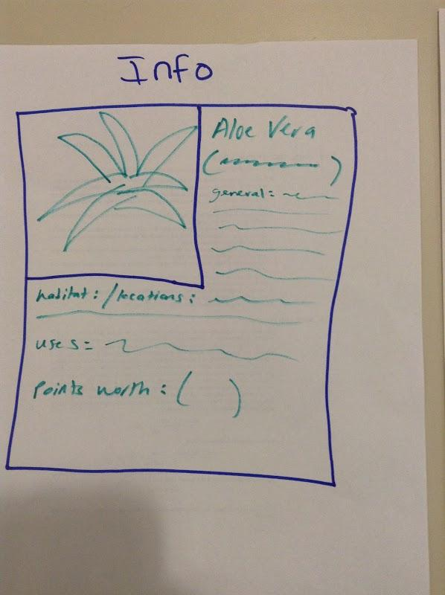
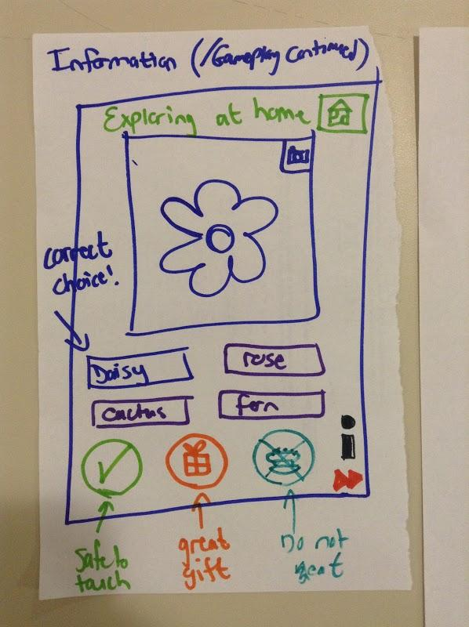
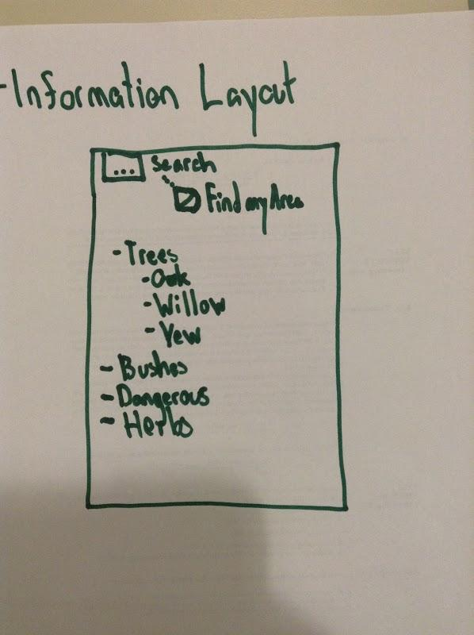
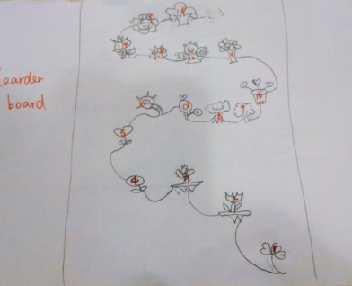
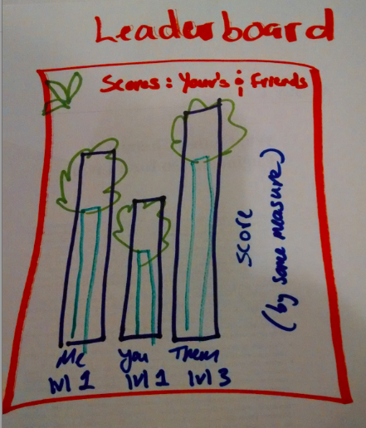
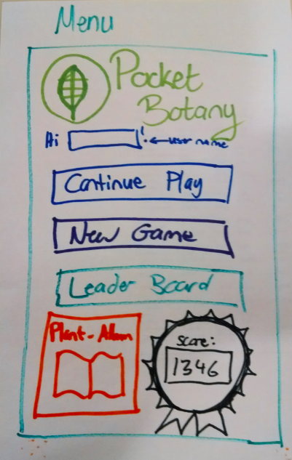
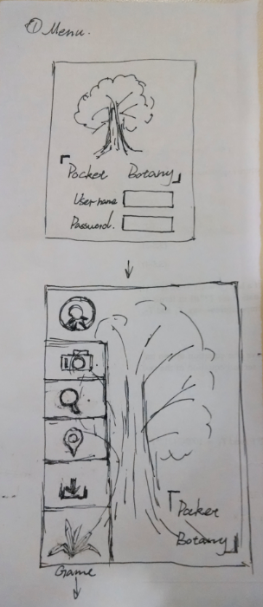
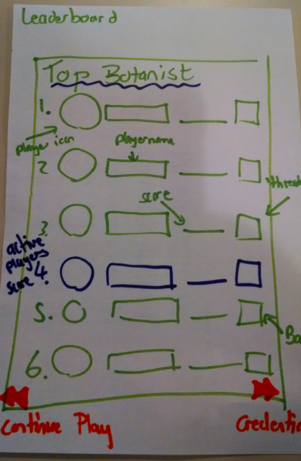
4. Feature development / paper prototypes

Slide 3
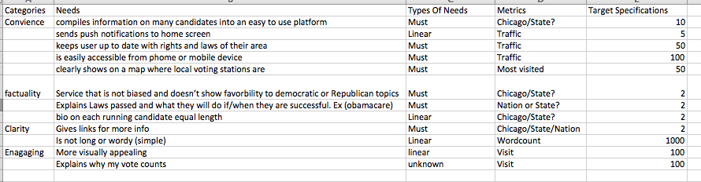
Step 1: create alternative features based on needs
For each need….
Ask “what are WAYS OF (you can also use how might we…) keeping the user up to date with rights and laws of their area?” Create at least 5 alternative ways of solving for each need.

Slide 4
Step 1: create alternative features based on needs
This should be both a team and individual activity.
Defer judgment – think of what is possible, not only what is likely. Your ideas should span from mild to wild.
You should be generating specific solutions (e.g. enter credit card number by taking a picture of the credit card) NOT strategies or principles (e.g. make it easier to add a credit card number).
Try to sketch even if you do not think you can draw.
Focus on creating variety and coverage – do not fall in love with one idea and then just develop variants.

Slide 5
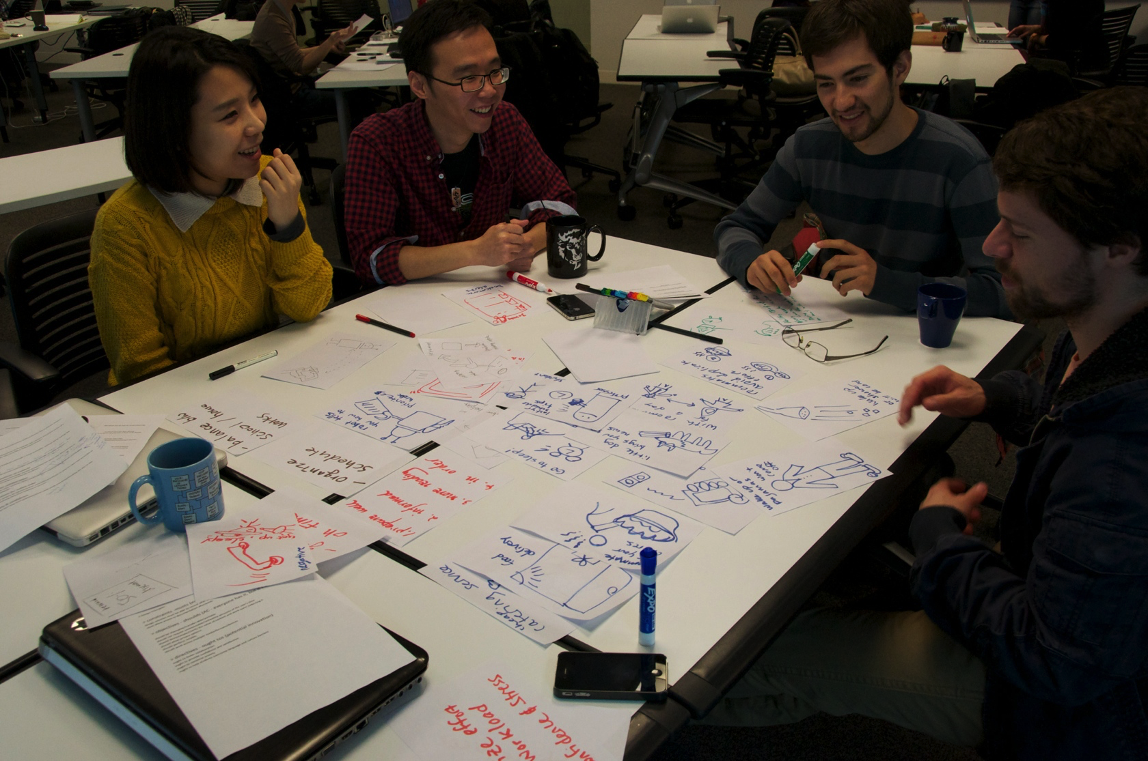
Step 1: this is what this exercise should feel like:

Slide 6
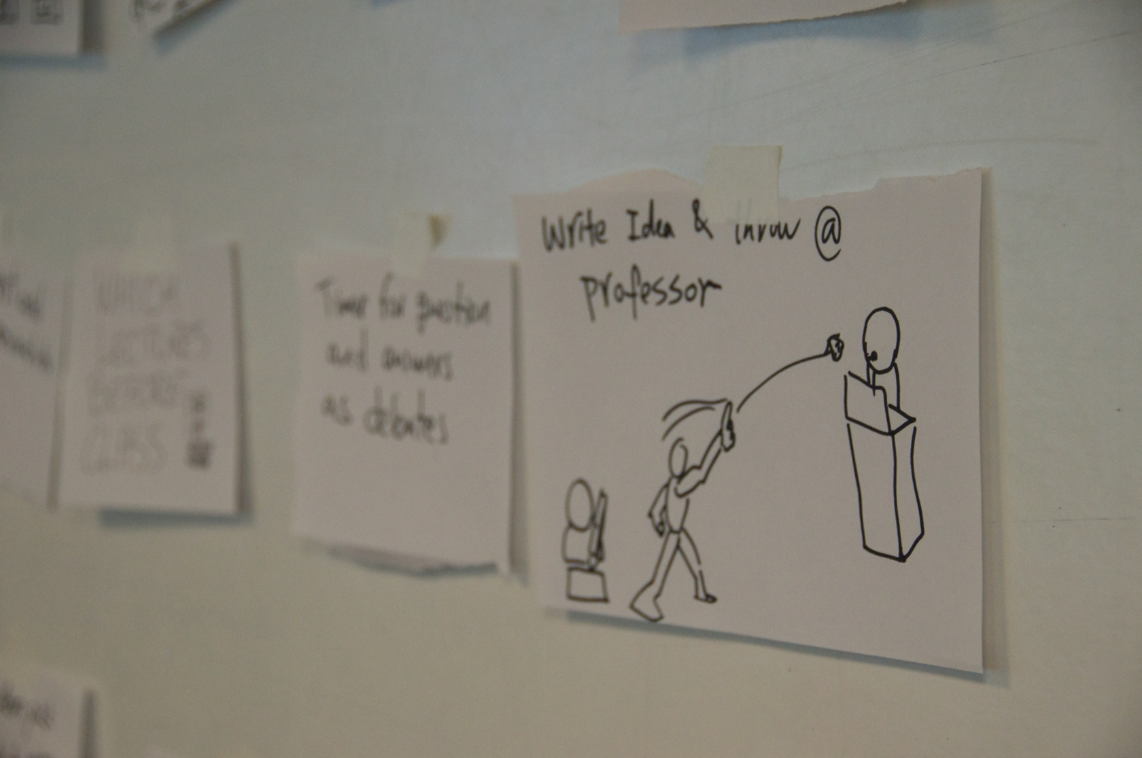
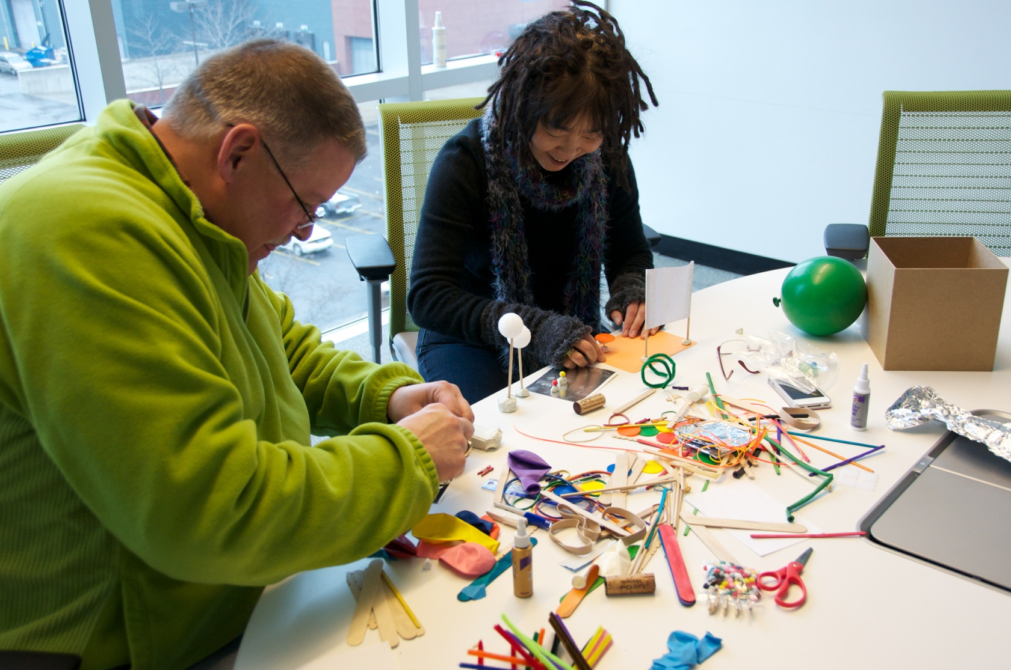
Step 1: this is what this exercise should feel like:
Document through sketches:
Build rough prototypes if it helps:

Slide 7
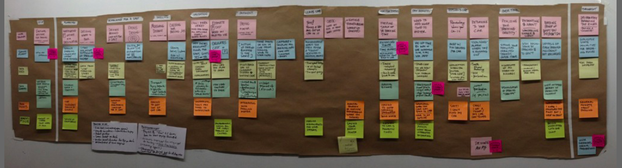
Step 1: create alternative features based on needs
Develop a large set of features based on your needs. Use a large piece of butcher paper to organize your ideas – put the needs on top and the solutions in columns under the needs. You should have at least 10 needs and 5 ideas per need. Use sticky notes or half sheets of paper taped on the butcher paper.
Need (from last exercise)
Possible features / functions / interactions
Be sure to take a picture and document your idea set

Slide 8
Step 2: orchestrate a new user journey using the features you created
Blah blah blah, what does that mean?
orchestrate a new user journey using the features you created that delivers on your Project objective
What is each feature is doing; how and when it is doing it.
You have already created a user journey for the existing situation. Your new features will help you create a new user journey (composed of activities and features – we can also call features “touch points”).
Select a group of features that best addresses your project objective from your charter document
A key interaction (with data / objects / people) that solves for a real user need. It is important to understand the importance of each interaction to the user.

Slide 9
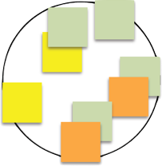
Step 2: orchestrate a new user journey using the features you created
Your new user journey should be composed from two components:
1. New user scenario
Step 1
Step 2
Step 3
Step 4
Step 5
Step 6
Step 7
2. Clusters of mutually reinforcing features that solve for user needs at each stage of the scenario

Slide 10
Step 2: orchestrate a new user journey using the features you created
Your new user journey should be composed from two components:
1. New user scenario
Step 1
Step 2
Step 3
Step 4
Step 5
Step 6
Step 7
Scenarios are a future, more ideal version of your initial user journey. They are intended to illustrate how a new service design will address unmet needs and help users achieve their goals or objectives. Very simply, we imagine the proposed design for the service has been implemented, and run through the story showing how our user interacts with and benefits from the system. A good scenario is a sequence of BELIEVABLE user activities, each supported by interactions with the new service design. The scenario highlights both technical features and emotional benefits. IT SHOULD BE BASED ON THE USER JOURNEYS YOU DEVELOPED DURING RESEARCH, MINUS THE STEPS THAT CAN BE ELIMINATED DUE TO YOUR NEW IDEAS / INCLUDING ANY NEW STEPS YOUR IDEAS MAY ENABLE.
2. Clusters of mutually reinforcing features that solve for user needs at each stage of the scenario

Slide 11
Step 2: orchestrate a new user journey using the features you created
Features should be mutually reinforcing – meaning that they should work well together and support each other’s main function. Also, do not spend time designing features that are required but already exist (logging in, entering demographic data). Instead focus your effort on features that are distinctive to your service. For each feature:
Describe (what does it do?)
Characterize (how does it feel?)
Measure (how do we know if it is successful?)
Your new user journey should be composed from two components:
1. New user scenario
Step 1
Step 2
Step 3
Step 4
Step 5
Step 6
Step 7
2. Clusters of mutually reinforcing features that solve for user needs at each stage of the scenario

Slide 12
Step 2: orchestrate a new user journey using the features you created
Step 1
Step 2
Step 3
Step 4
Step 5
Step 6
Step 7
Work iteratively: start by working top down - identify the ideal user sequence of activities, and then select the features that would support that sequence. Then work bottom up – cluster your key features and then determine the user sequence that would engage all of the clusters of features. Finally, develop a hybrid solution that takes the best from most models – your goal is elegance (the most benefit for the least amount of work).

Slide 13
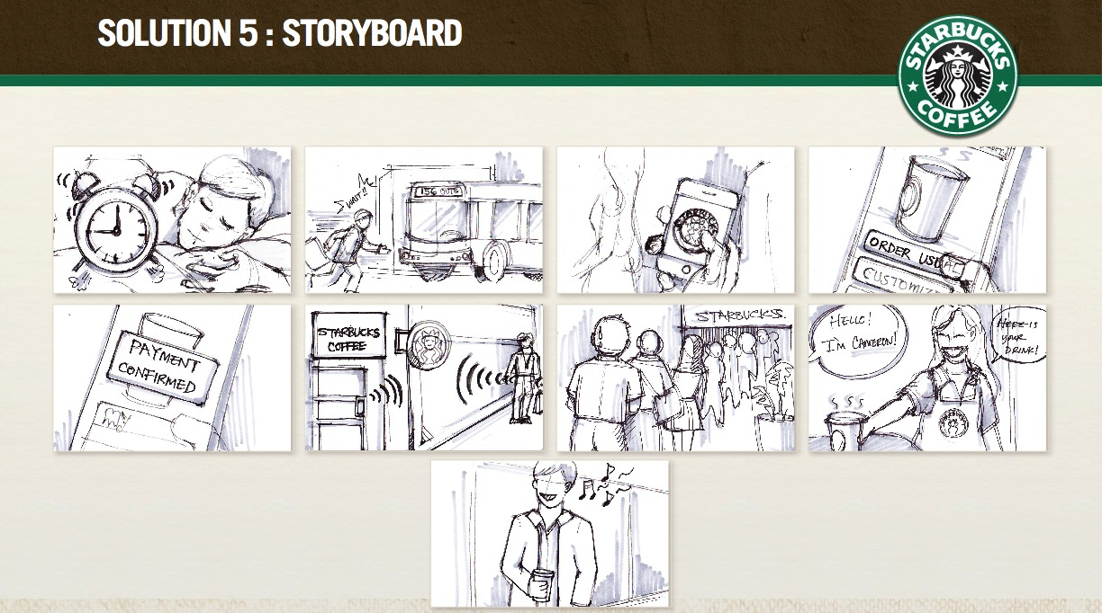
Example:

Slide 14
Assignment
Complete steps 1 and 2. Be sure to thoroughly document step 1 through pictures (posted to iGroups). Create a new user journey. At the very least (this is option 1) all features should be illustrated (like the rough sketches on slide 2). If you choose this option you also need to create a diagram that lists user actions and related features (like the Miller’s pizza journey). Ideally (this is option 2) you would create an integrated illustration (like slide 13) that shows how each feature, in context, supports the user journey.

